Slide 1
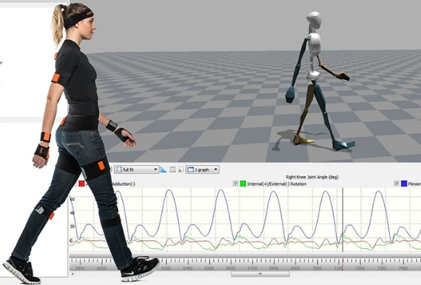
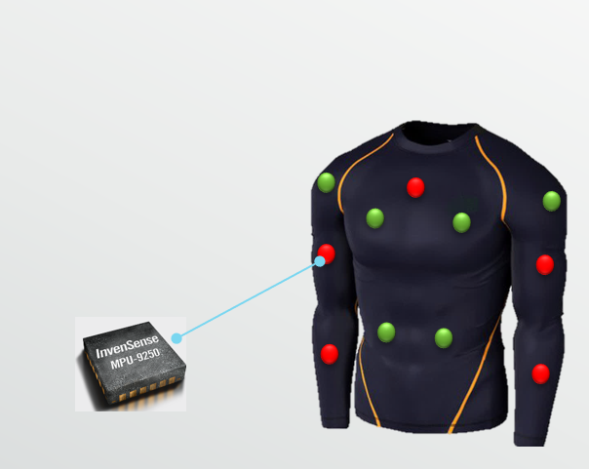
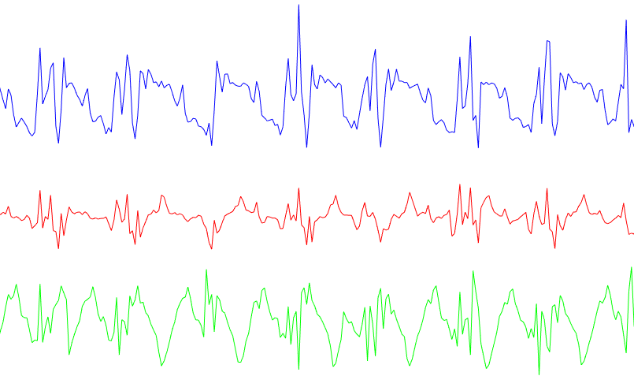
Challenges in Sensor-based Human Activity Recognition
IMU (Inertial measurement unit）
3-axis accelerometer,
3-axis gyroscope,
3-axis magnetometer

Slide 2
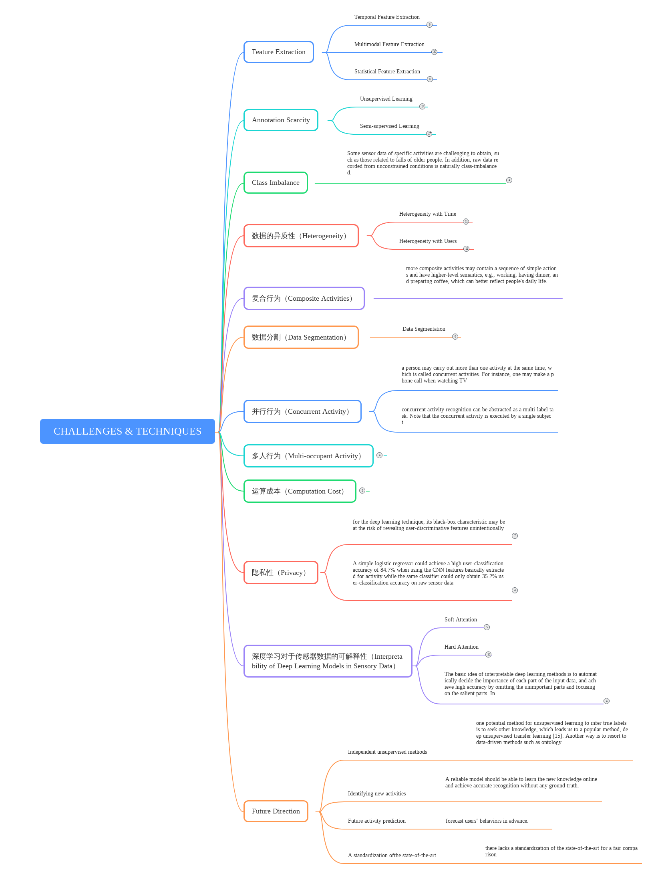
Challenges
Feature Extraction
Annotation Scarcity (注释稀缺性)
Class Imbalance
Heterogeneity (数据异质性)
Interpretability of Deep Learning Models in Sensory Data
Data Segmentation
Composite Activities（复合行为）
Concurrent Activity (并行行为)
Multi-occupant Activity (多人行为)
Computation Cost （运算成本）
Privacy

Slide 3
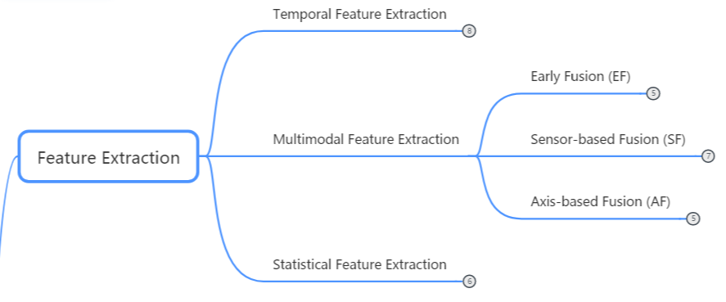
Feature Extraction

Slide 4
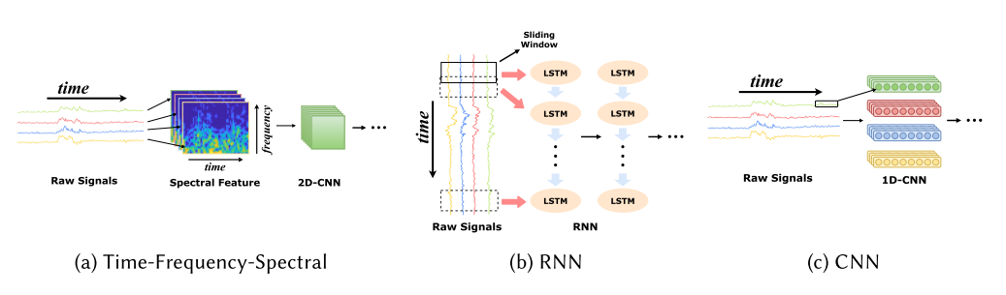
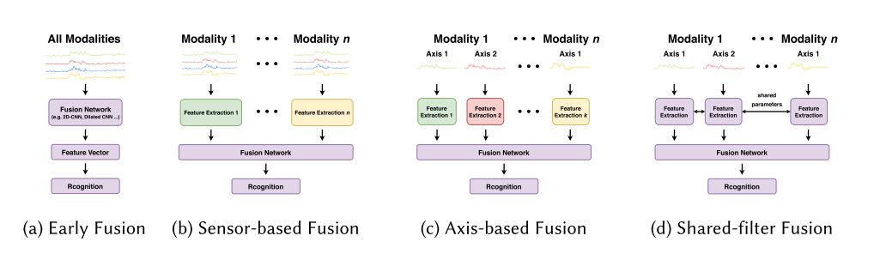
Feature Extraction
Temporal Feature
Multimodal extraction

Slide 5
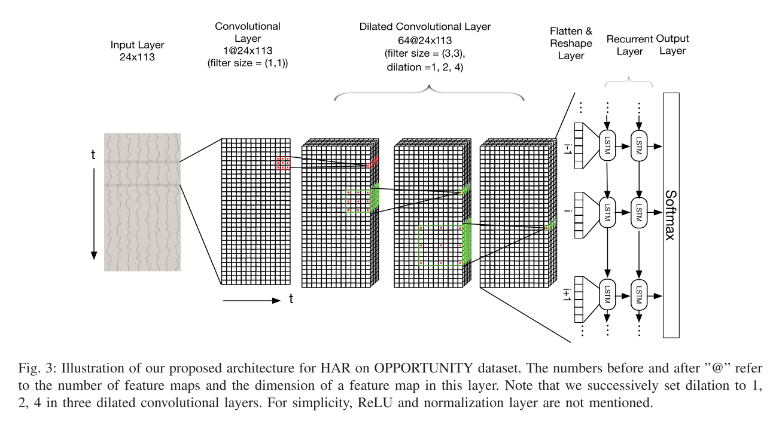
29. Rui Xi, Mengshu Hou, Mingsheng Fu, Hong Qu, and Daibo Liu. 2018. Deep dilated convolution on multimodality time series for human activity recognition. In 2018 International Joint Conference on Neural Networks (IJCNN). IEEE, 1–8
Feature Extraction Temporal Feature Extraction
Expand the temporal features. Muti-kernel consume more computational resources. Applied a deep dilated CNN to time series for solving the issues. The dilated CNN uses dilated convolution kernels instead of the standard convolutional kernels to expand the convolution receptive field (i.e., time length) with no loss of resolution.
Because the dilated kernel only adds empty elements between the elements of the conventional convolution kernel, it does not require an extra computational cost.

Slide 6
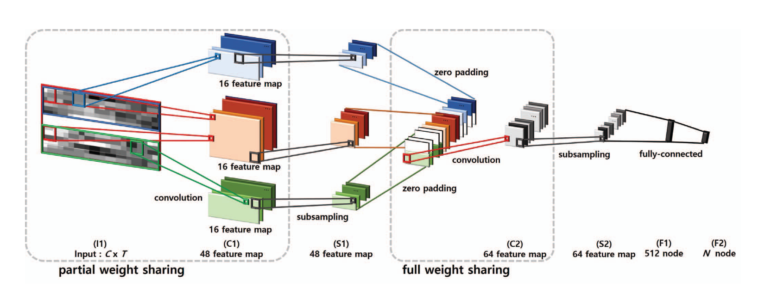
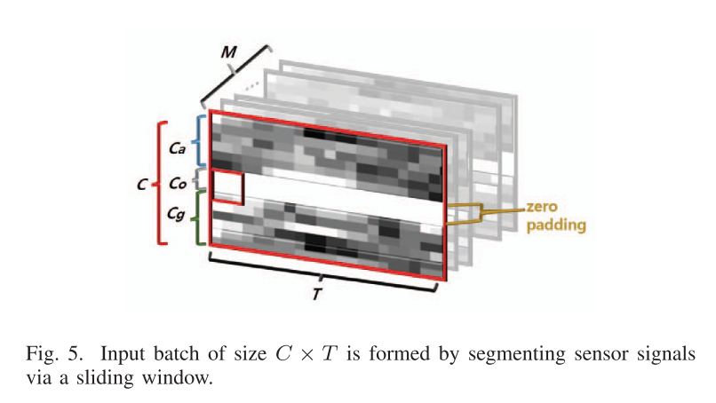
8. Sojeong Ha and Seungjin Choi. 2016. Convolutional neural networks for human activity recognition using multiple accelerometer and gyroscope sensors. In 2016 International Joint Conference on Neural Networks (IJCNN). IEEE, 381–388.
Feature Extraction Temporal Feature Extraction Sensor-based Fusion (SF)
Proposed to create a vector of different modalities at the early stage as well and to extract the common characteristics across modalities along with the sensor-specific characteristics; then both kinds of features are fused at the later part of the model.
However for multi-modal data (accelerometer and gyroscope), [14] share weights for whole input signals in convolutional layer (full weights sharing), and extract same features without distinction of modalities, which might cause interferences between characteristics produced by accelerometers and gyroscopes for capturing modality-specific features.

Slide 7
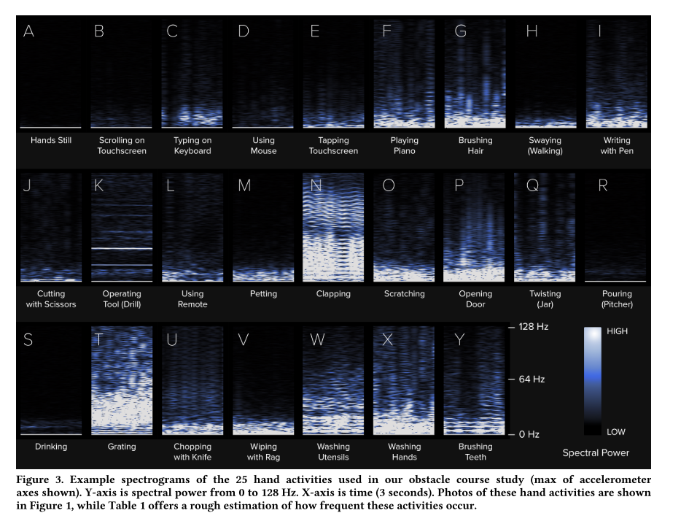
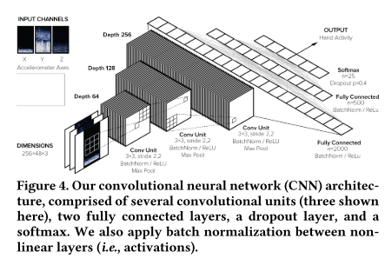
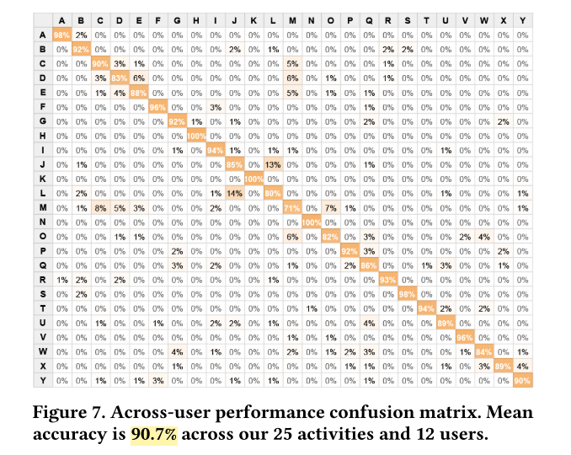
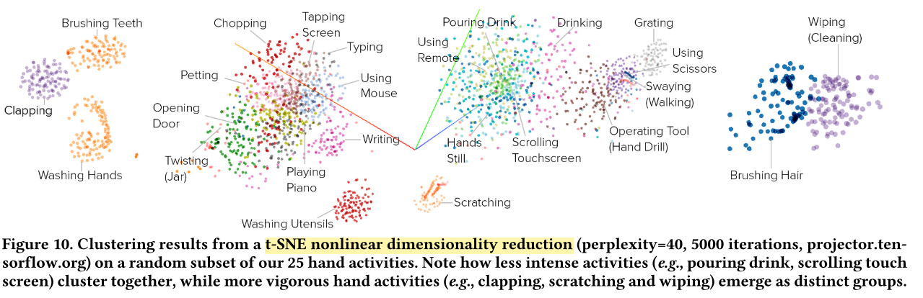
14. Gierad Laput and Chris Harrison. 2019. Sensing Fine-Grained Hand Activity with Smartwatches. In Proceedings ofthe 2019 CHIConference on Human Factors in Computing Systems. ACM, 338.
Feature Extraction Temporal Feature Extraction Axis-based Fusion (AF).
Developed a fine-grained hand activity sensing system through the combination of the time-frequency-spectral features and CNNs.
They demonstrated 95.2% classification accuracy over 25 atomic hand activities of 12 people.
The spectral features can not only be used for the wearable sensor activity recognition but also be used for the device-free activity recognition.
..\paper\14.pdf

Slide 8
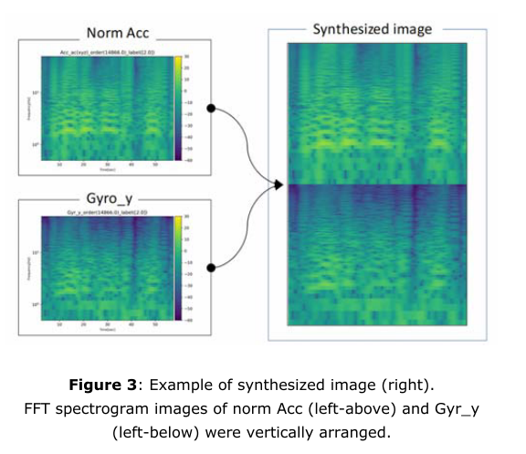
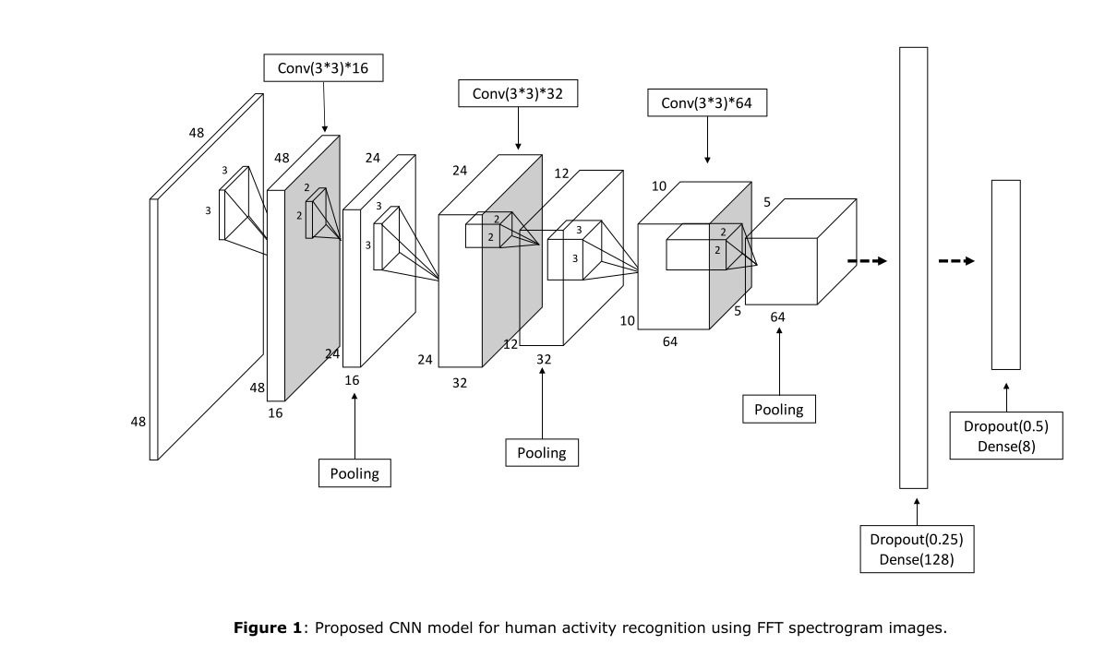
11. Chihiro Ito, Xin Cao, Masaki Shuzo, and Eisaku Maeda. 2018. Application of CNN for human activity recognition with FFT spectrogram of acceleration and gyro sensors. In Proceedings ofthe 2018 ACM International Joint Conference and 2018 International Symposium on Pervasive and Ubiquitous Computing andWearable Computers. ACM, 1503–1510
Feature Extraction Temporal Feature Extraction Axis-based Fusion (AF).
Temporal features of acceleration and gyro signals are first represented by FFT spectrogram images and then vertically combined into a larger image for the following DCNN to learn inter-modality features.

Slide 9
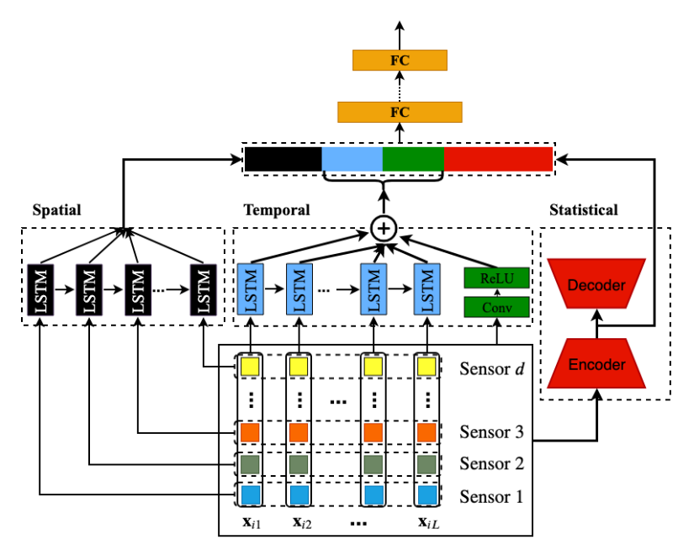
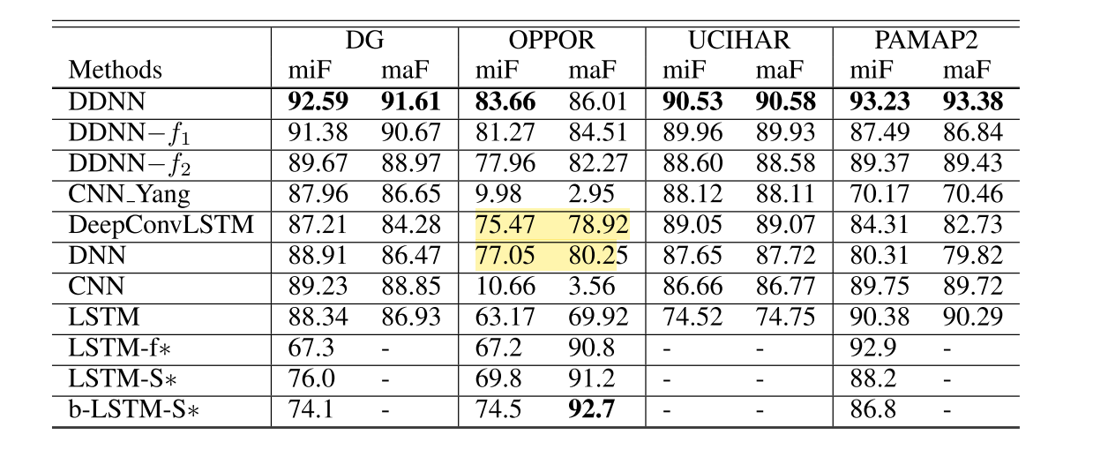
21. Hangwei Qian, Sinno Jialin Pan, Bingshui Da, and Chunyan Miao. 2019. A Novel Distribution-Embedded Neural Network for Sensor-Based Activity Recognition. In Proceedings ofthe Twenty-Eighth International Joint Conference on Artificial Intelligence, IJCAI 2019, Macao, China, August 10-16, 2019. 5614–5620
Feature Extraction Statistical Feature Extraction.
Managed to develop a Distribution-Embedded Deep Neural Network (DDNN) to integrate the statistical feature extraction process into an end-to-end for activity recognition.
It encoded the idea of kernel embedding of distributions into a deep architecture, such that all orders of statistical moments could be extracted as features to represent each segment of sensor readings, and further used for activity classification in an end-to-end training manner.

Slide 10
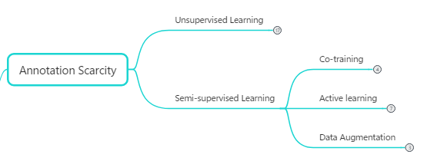
Annotation Scarcity

Slide 11
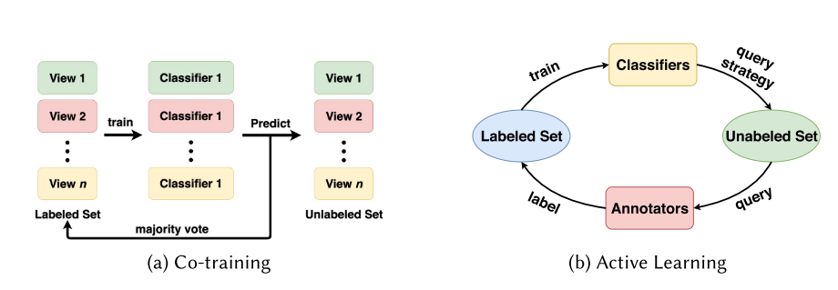
Annotation Scarcity
Unsupervised Learning
Deep generative models such as Deep Belief Networks (DBNs) and autoencoders
They are useful in extracting features and finding patterns in massive data.
semi-supervised Learning
Co-training : extension of self-learning
Active Learning: requires annotators who are usually experts or users to label the data manually.

Slide 12
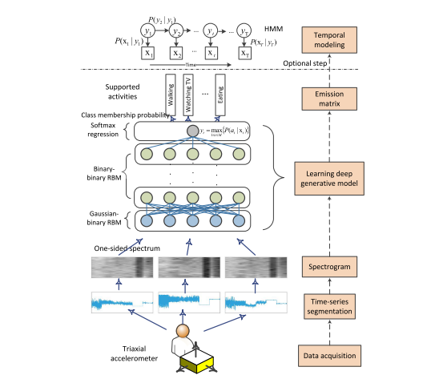
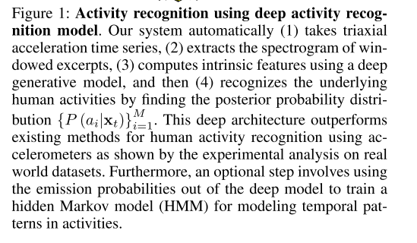
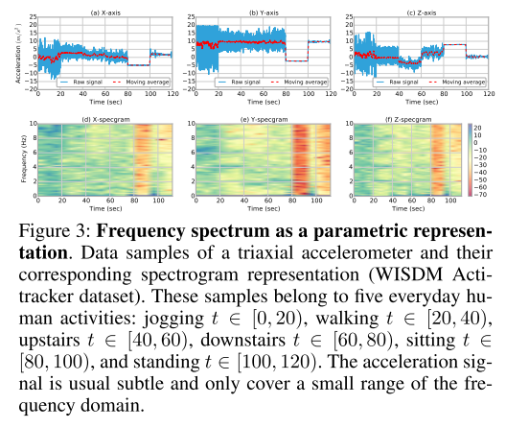
Mohammad Abu Alsheikh, Ahmed Selim, Dusit Niyato, Linda Doyle, Shaowei Lin, and Hwee-Pink Tan. 2016. Deep activity recognition models with triaxial accelerometers. In Workshops at the Thirtieth AAAI Conference on Artificial Intelligence
Annotation Scarcity Unsupervised Learning

Slide 13
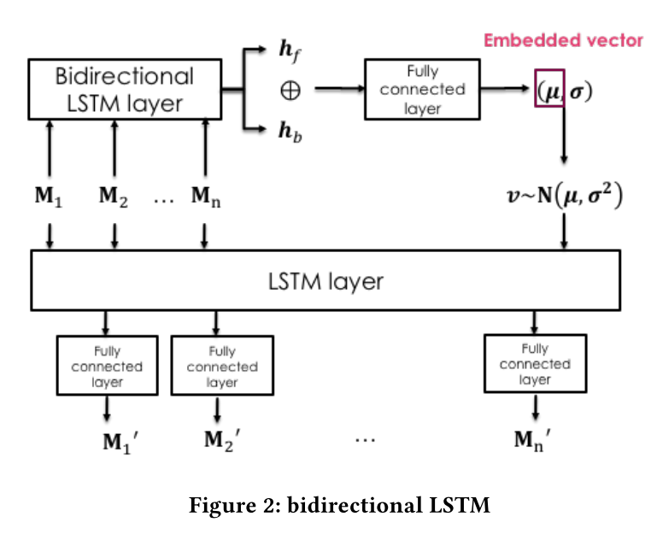
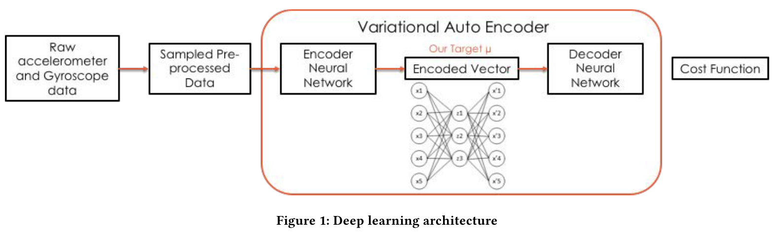
2. Lu Bai, Chris Yeung, Christos Efstratiou, and Moyra Chikomo. 2019. Motion2Vector: unsupervised learning in human activity recognition using wrist-sensing data. In Proceedings ofthe 2019 ACM International Joint Conference on Pervasive and Ubiquitous Computing and Proceedings of the 2019ACM International Symposium onWearable Computers. ACM, 537–542.
Annotation Scarcity Unsupervised Learning
Proposed a method called Motion2Vector to convert a time period of activity data into a movement vector embedding within a multidimensional space.
To fit with the context of activity recognition, they use a bidirectional LSTM to encode the input blocks of the temporal wrist-sensing data.
Two hidden states generated are concatenated to form the embedded vectors which can be considered as an appropriate representation of the input movement.
Classifiers such as C4.5, K nearest neighbor, and random forest are trained later for classification.
The experiments showed that this method can achieve accuracy of higher than 87% when tested on public datasets

Slide 14
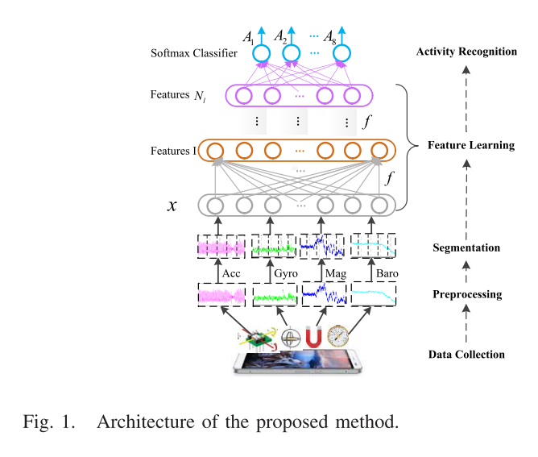
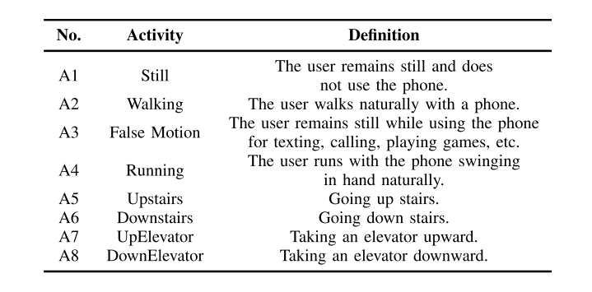
7. Fuqiang Gu, Kourosh Khoshelham, Shahrokh Valaee, Jianga Shang, and Rui Zhang. 2018. Locomotion activity recognition using stacked denoising autoencoders. IEEE Internet ofThings Journal 5, 3 (2018), 2085–2093.
Annotation Scarcity Unsupervised Learning
we propose a deep learning method for LAR, which consists of stacked denoising autoencoders
Moreover, the proposed method can make use of unlabeled data for model fitting in an unsupervised pretraining phase, which is especially useful when labeled data are scarce

Slide 15
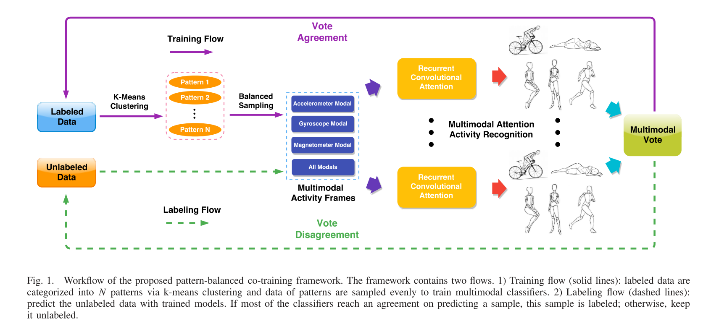
6. Kaixuan Chen, Lina Yao, Dalin Zhang, Xianzhi Wang, Xiaojun Chang, and Feiping Nie. 2019. A semisupervised recurrent convolutional attention model for human activity recognition. IEEE transactions on neural networks and learning systems (2019).
Annotation Scarcity Semi-supervised Learning Co-training
Applied co-training with multiple classifiers on different modalities of the data.
Three classifiers are trained on acceleration, angular velocity, and magnetism, respectively.
The learned classifiers are used for predicting the unlabeled data after each training round.
If most of the classifiers reach an agreement on predicting an unlabeled sample, this sample is labeled and moved to the labeled set for the next training round.
The training flow is repeated until no confident samples can be labeled, or the unlabeled set is empty. Then a new classifier is trained on the final labeled set with all modalities

Slide 16
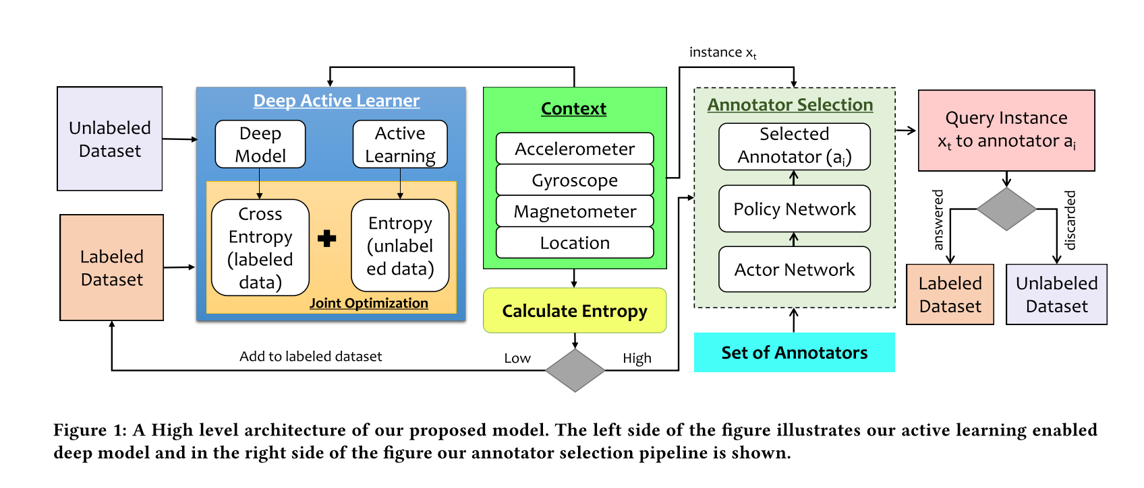
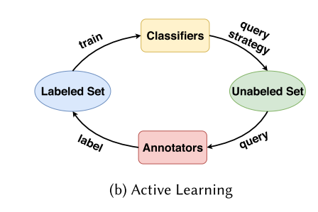
10. HM Hossain and Nirmalya Roy. 2019. Active Deep Learning for Activity Recognition with Context Aware Annotator Selection. In Proceedings ofthe 25th ACM SIGKDD International Conference on Knowledge Discovery & Data Mining. ACM, 1862–1870.
Annotation Scarcity Semi-supervised Learning Active learning
The first problem is that outliers can be easily mistaken for important samples. When entropy is calculated for selection, apart from informativeness, larger entropy may also mean outliers because outliers belong to none of the classes. Therefore, a joint loss function was proposed
The second problem considered in this work is how to reduce the workload of annotators as annotators are required to master domain knowledge for accurate labels. Multiple annotators are employed in this work. They are selected from the intimate people of users. The annotator selection is made by the reinforcement learning algorithm according to the heterogeneity and the relations of users. The contextual similarity is used to measure the relations among users and annotators. The experimental results show that this work has an 8% improvement in accuracy and has a higher convergence rate.

Slide 17
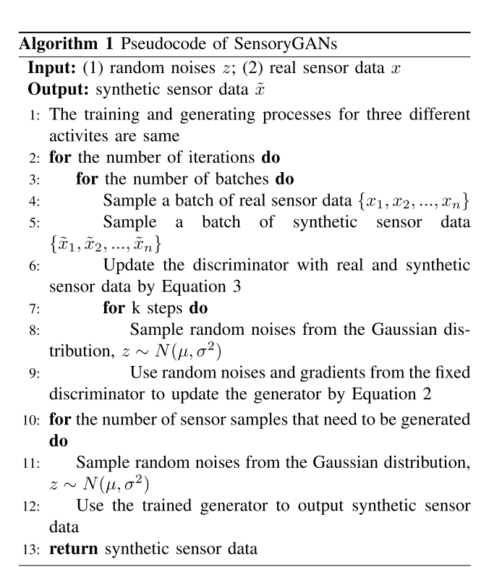
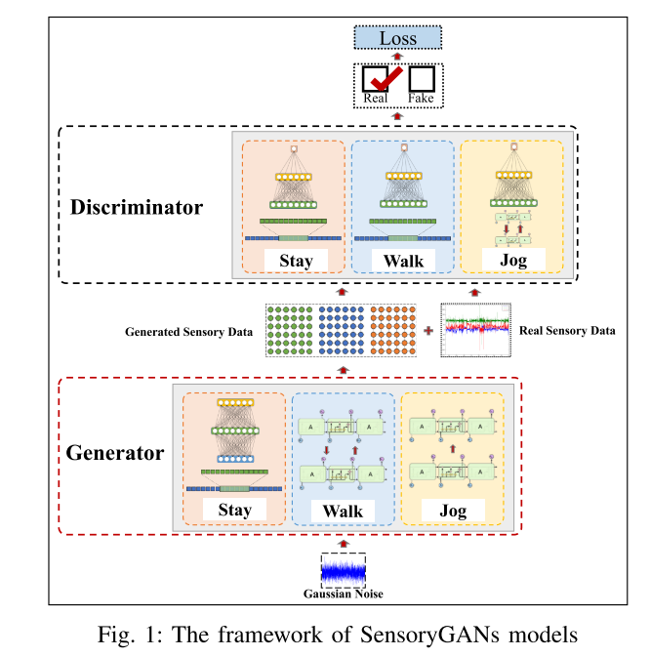
27. Jiwei Wang, Yiqiang Chen, Yang Gu, Yunlong Xiao, and Haonan Pan. 2018. SensoryGANs: An Effective Generative Adversarial Framework for Sensor-based Human Activity Recognition. In 2018 International Joint Conference on Neural Networks (IJCNN). IEEE, 1–8
Annotation Scarcity Data augmentation
As sensory data is heterogeneous, a unified GAN may not be enough to depict the complex distribution of different activity,
Wang et al. employed three activity-specific GANs for three activities. After generation, the synthetic data are fed into classifiers for prediction with original data.
We should note that although this work uses deep generative networks, the generation process depends on labels so the process is not unsupervised.

Slide 18
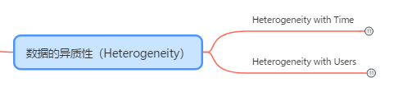
Heterogeneity

Slide 19
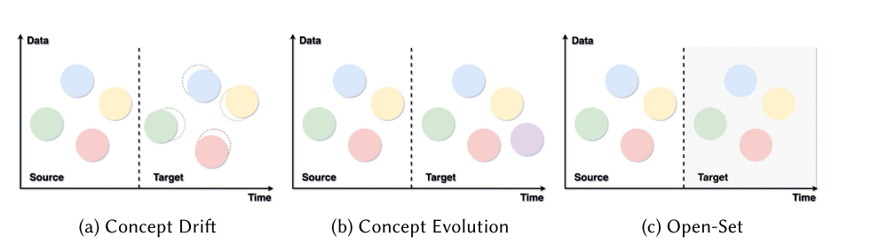
Heterogeneity
Users:
Owing to biological and environmental factors, the same activity can be performed differently by different individuals.
Time:
the streaming sensory data changes over time.

Slide 20
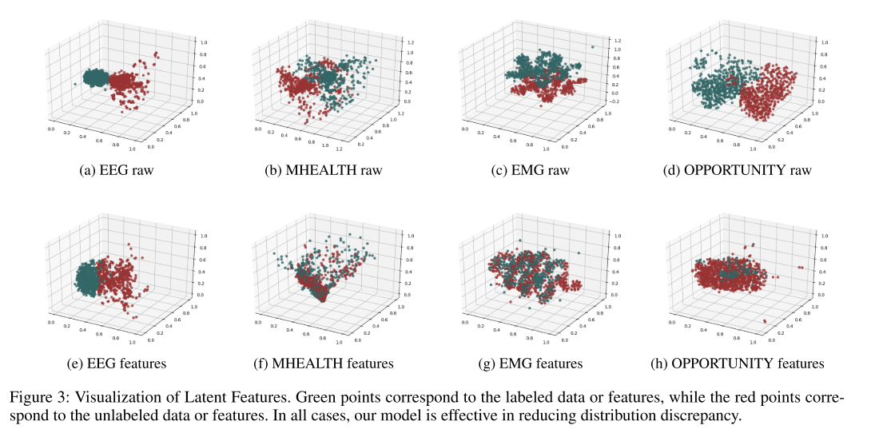
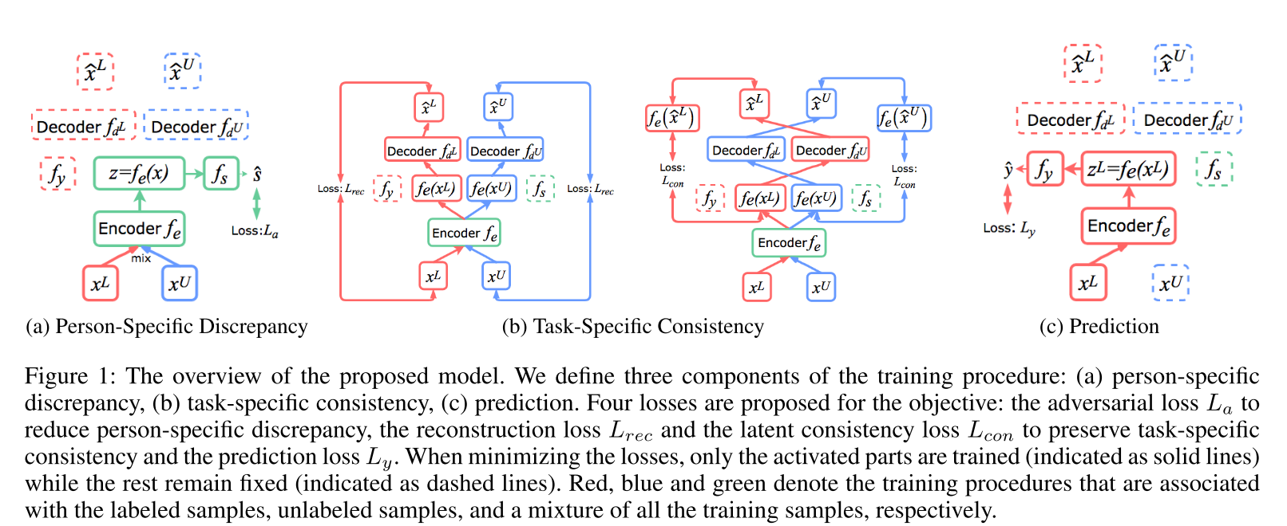
4. Kaixuan Chen, Lina Yao, Dalin Zhang, Xiaojun Chang, Guodong Long, and Sen Wang. 2019. Distributionally Robust Semi-Supervised Learning for People-Centric Sensing. In The Thirty-Third AAAIConference on Artificial Intelligence, AAAI, Honolulu, Hawaii USA, January 27 February 1, 2019. 3321–3328.
Defined person-specific discrepancy and task-specific consistency for people-centric sensing applications.
Person-specific discrepancy means the distribution divergence of data collected from different people, and task-specific consistency denotes the inherent similarity of the same activity.
Their learned features not only reduce person-specific discrepancy but also preserve task-specific consistency, guaranteeing the recognition accuracy after transferring.
..\paper\4.pdf.pdf

Slide 21
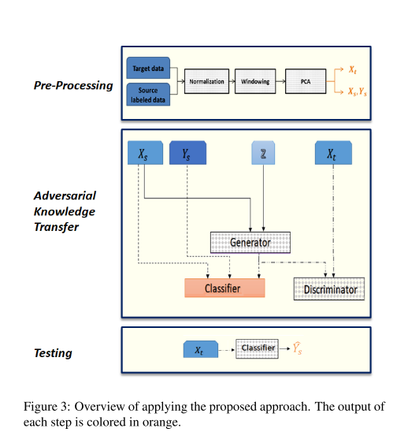
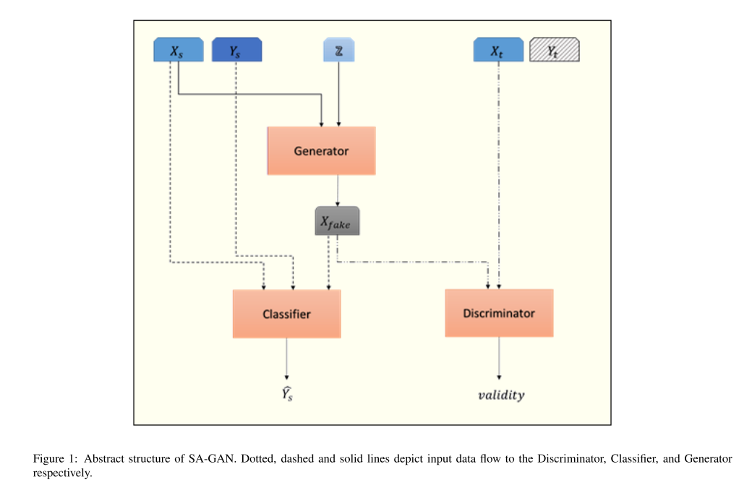
25. Elnaz Soleimani and Ehsan Nazerfard. 2019. Cross-Subject Transfer Learning in Human Activity Recognition Systems using Generative Adversarial Networks. arXiv preprint arXiv:1903.12489 (2019).
Heterogeneity User
The authors generated data of the target domain directly from the source domain with GANs to enhance the training of the classifier.
This paper presents a novel method of adversarial knowledge transfer named SA-GAN stands for Subject Adaptor GAN which utilizes Generative Adversarial Network frame- work to perform cross-subject transfer learning in the domain of wearable sensor-based Human Activity Recognition.

Slide 22
22. Seyed Ali Rokni, Marjan Nourollahi, and Hassan Ghasemzadeh. 2018. Personalized Human Activity Recognition Using Convolutional Neural Networks. In Thirty-Second AAAIConference on Artificial Intelligence
Proposed to personalize their models with transfer learning.
In the training phase, CNN is firstly trained with data collected from a few participants (source domain).
In the test phase, only the top layers of the CNN are fine-tuned with a small amount of data for the target users (target domain).
Annotation for target users is required. GAN is also serviceable for addressing heterogeneity with users.

Slide 23
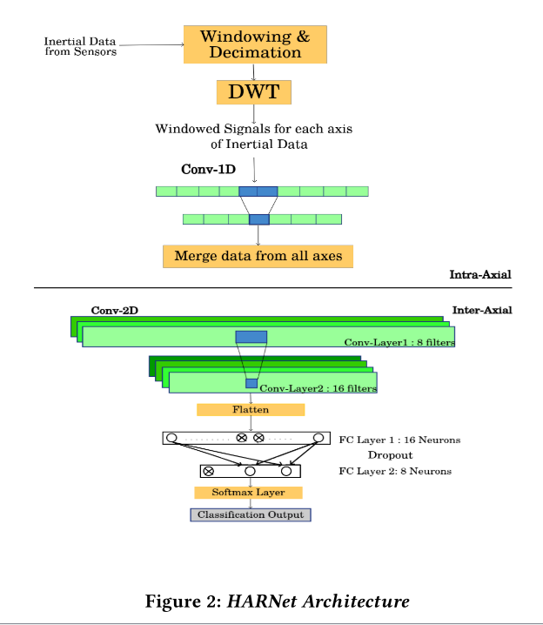
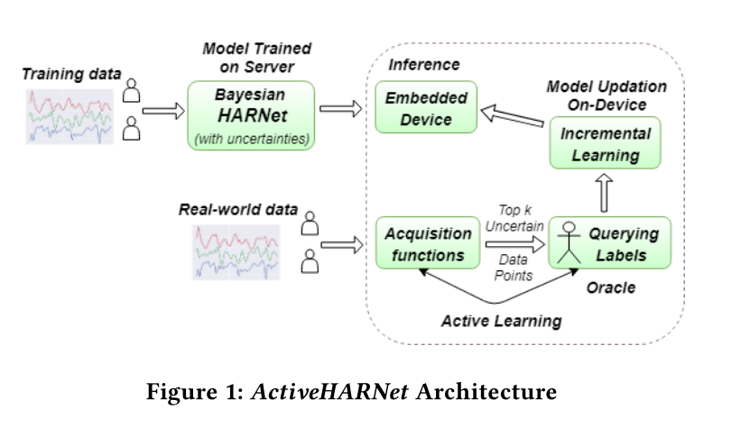
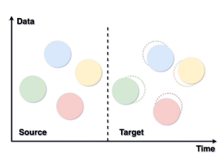
38. Gautham Krishna Gudur, Prahalathan Sundaramoorthy, and Venkatesh Umaashankar. 2019. ActiveHARNet: Towards On-Device Deep Bayesian Active Learning for Human Activity Recognition. arXiv preprint arXiv:1906.00108 (2019)
Heterogeneity with Time
Active learning is a special type of incremental learning. In streaming data systems, active learning is able to query ground truth for some samples when change is detected in the data streams. It encourages to select the most efficient samples to update the models for the new concepts.
proposed a deep Bayesian CNN with dropout to obtain the uncertainties of the model and select the most informative data points to be queried according to the uncertainty query strategy. Owing to the active learning, the model supports updating continuously and capturing the changes of data over time.

Slide 24
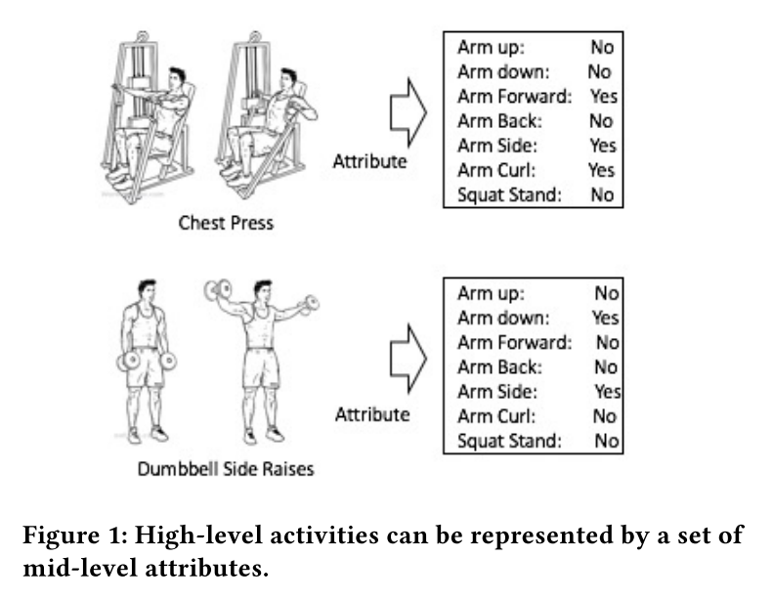
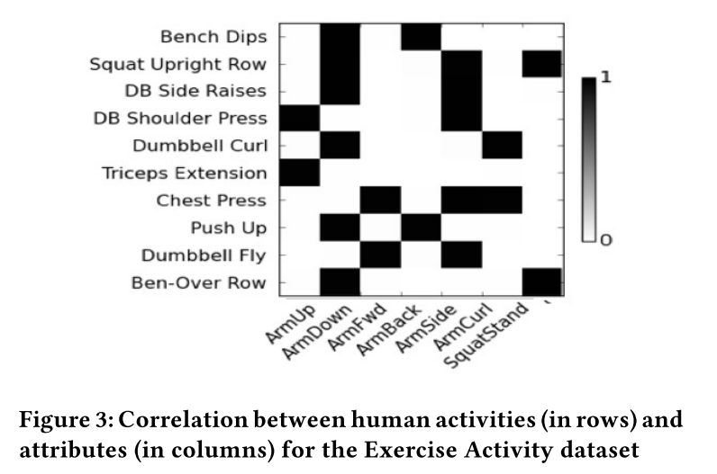
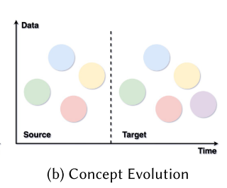
16. Harideep Nair, Cathy Tan, Ming Zeng, Ole J Mengshoel, and John Paul Shen. 2019. AttriNet: learning mid-level features for human activity recognition with deep belief networks. In Proceedings ofthe 2019 ACM International Joint Conference on Pervasive and Ubiquitous Computing and Proceedings ofthe 2019 ACM International Symposium on Wearable Computers. ACM, 510–517.
In the application phase, the concepts of the new activities still need to be learned.
It is essential to study activity recognition systems which can recognize new activities in the streaming data settings.
It is difficult due to the restricted access to annotated data in the application phase. One approach is to decompose activities into mid-level features such as arm up, arm down, leg up, and leg down. This method demands experts to define the mid-level attributes for further training, and the capability is limited when new activities composed of new attributes appear

Slide 25
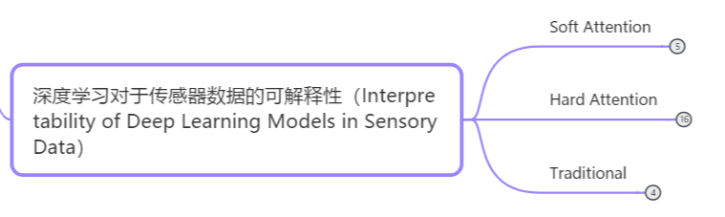
Interpretability of Deep Learning Models in Sensory Data

Slide 26
Interpretability of Deep Learning Models in Sensory Data
Soft:
“soft” means differentiable. Soft attention assigns weight from 0 to 1 to each element of the inputs.
Hard:
whether to attend to a part of inputs or not

Slide 27
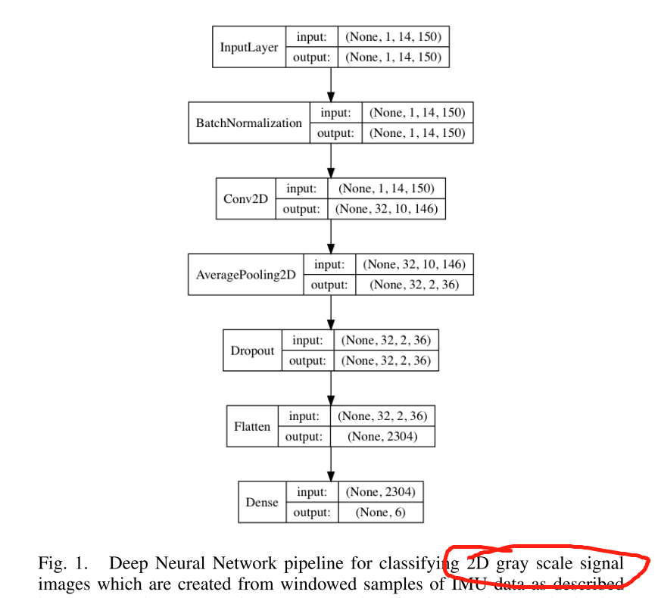
17. Mark Nutter, Catherine H Crawford, and Jorge Ortiz. 2018. Design of Novel Deep Learning Models for Real-time Human Activity Recognition with Mobile Phones. In 2018 International Joint Conference on Neural Networks (IJCNN). IEEE, 1–8.
Interpretability of Deep Learning Models in Sensory Data Traditional
Present a detailed study of the traditional hand-crafted features used for shallow/statistical models that consist of a over 561 manually chosen set of dimensions.
We show, through (PCA) and (SVM) pipeline, that the number of features can be significantly reduced – less than 100 features that give the same performance.
In addition, we show that features derived from frequency-domain transformations do not contribute to the accuracy of these models.
Finally, we provide details of our learning technique which creates 2D signal images from windowed samples of IMU data.

Slide 28
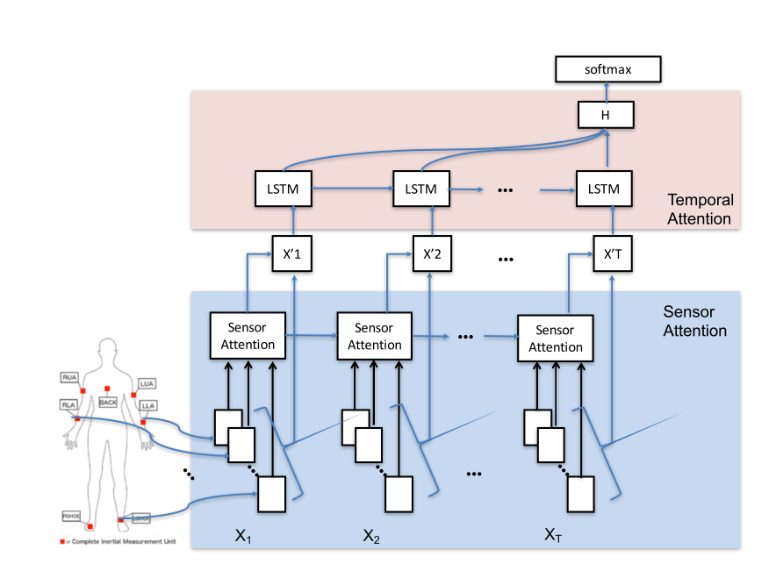
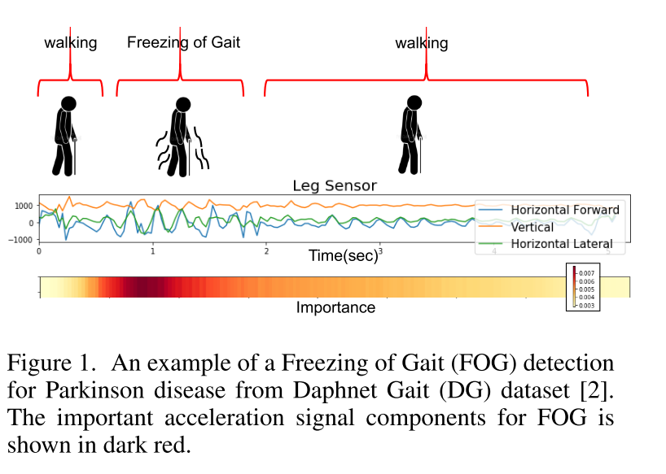
32. Ming Zeng, Haoxiang Gao, Tong Yu, Ole J Mengshoel, Helge Langseth, Ian Lane, and Xiaobing Liu. 2018. Understanding and improving recurrent networks for human activity recognition by continuous attention. In Proceedings ofthe 2018 ACM International Symposium on Wearable Computers. ACM, 56–63
Interpretability of Deep Learning Models in Sensory Data Soft Attention
Developed attention mechanisms in two perspectives.
They first propose sensor attention on the inputs to extract the salient sensory modalities and then apply temporal attention to an LSTM to filter out the inactive data segments. Spatial

Slide 29
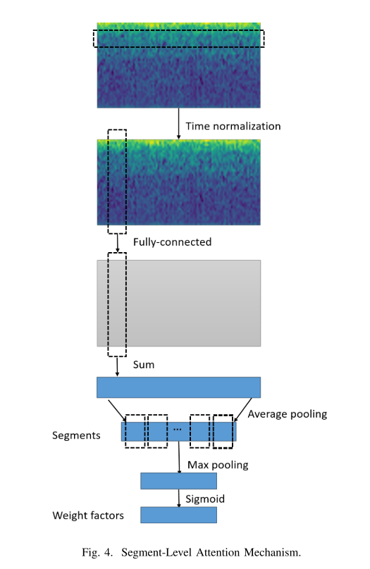
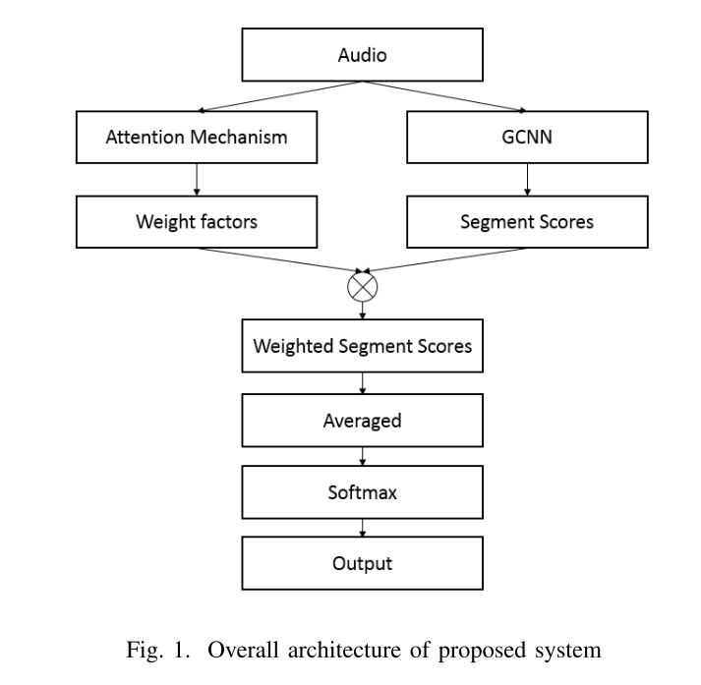
24. Yu-Han Shen, Ke-Xin He, and Wei-Qiang Zhang. 2018. SAM-GCNN: A Gated Convolutional Neural Network with Segment-Level Attention Mechanism for Home Activity Monitoring. In 2018 IEEE International Symposium on Signal Processing and Information Technology (ISSPIT). IEEE, 679–684.
Interpretability of Deep Learning Models in Sensory Data Soft Attention
Considered the temporal context.
They designed a segment-level attention approach to decide which time segment contains more information.
Combined with gated CNN, the segment-level attention better extracts temporal dependencies.

Slide 30


5. Kaixuan Chen, Lina Yao, Dalin Zhang, Bin Guo, and Zhiwen Yu. 2019. Multi-agent Attentional Activity Recognition. In Proceedings ofthe Twenty-Eighth International Joint Conference on Artificial Intelligence, IJCAI, Macao, China, August 10-16, 2019. 1344–1350.
Interpretability of Deep Learning Models in Sensory Data Hard Attention
further considered the intrinsic relations between activities and sub- motions from human body parts.
They employ multiple agents to concentrate on modalities that are related to sub-motions.
Multiple agents coordinate to portray the activities.
The visualization of the selected modalities and body parts validates that the attention mechanism provides insights into how sensory data elements affect the models’ prediction of activities.

Slide 31

36. Xiang Zhang, Lina Yao, Chaoran Huang, Sen Wang, Mingkui Tan, Guodong Long, and Can Wang. 2018. Multi- modality sensor data classification with selective attention. In Twenty-Seventh International Joint Conference on Artificial Intelligence.
Interpretability of Deep Learning Models in Sensory Data Hard Attention
use dueling deep Q networks as a core of hard attention to focus on the salient parts of multimodal sensory data
we introduce a selective attention mechanism into the reinforcement learning scheme to focus on the crucial dimensions of the data.

Slide 32

3. Kaixuan Chen, Lina Yao, XianzhiWang, Dalin Zhang, Tao Gu, Zhiwen Yu, and Zheng Yang. 2018. Interpretable parallel recurrent neural networks with convolutional attentions for multi-modality activity modeling. In 2018 International Joint
Interpretability of Deep Learning Models in Sensory Data Hard Attention
Mined important modalities and elide undesirable features with policy gradient.
The attention is embedded into an LSTM to make selections step by step because LSTM incrementally learns information in an episode.

Slide 33
Data Segmentation
Continuously streaming signals, a fixed-size window
Ideally, one partitioned data segment processes only one activity,
However, one window may not always share the same label

Slide 34


26. Alireza Abedin Varamin, Ehsan Abbasnejad, Qinfeng Shi, Damith C Ranasinghe, and Hamid Rezatofighi. 2018. Deep Auto-Set: A Deep Auto-Encoder-Set Network for Activity Recognition Using Wearables. In Proceedings ofthe 15th EAI International Conference on Mobile and Ubiquitous Systems: Computing, Networking and Services. ACM, 246–253
Data Segmentation
Varamin et al. designed a multi-label architecture to simultaneously predict the number of ongoing activities and the occurring possibility of each alternative activity within a window.
Using the optimal parameters learned from the training dataset, a Maximum A Posteriori (MAP) inference was adopted to output the most likely activity set by combining the multi-label outputs.

Slide 35


31. Rui Yao, Guosheng Lin, Qinfeng Shi, and Damith C Ranasinghe. 2018. Efficient dense labelling of human activity sequences from wearables using fully convolutional networks. Pattern Recognition 78 (2018), 252–266.
Data Segmentation
Fixed size sliding window has two key : i) the samples in one window may not always share the same label. Consequently, using one label for all samples within a window inevitably lead to loss of information; ii) the testing phase is constrained by the window size selected during training while the best window size is difficult to tune in practice.
We propose an efficient algorithm that can predict the label of each sample, which we call dense labeling, in a sequence of human activities of arbitrary length using a fully convolutional network.

Slide 36
Composite Activities（复合行为）
More composite activities may contain a sequence of simple actions and have higher-level semantics
Concurrent Activity (并行行为)
A person may carry out more than one activity at the same time
Multi-occupant Activity (多人行为)
Living and working spaces are usually resided by multiple subjects

Slide 37



23. Silvia Rossi, Roberto Capasso, Giovanni Acampora, and Mariacarla Staffa. 2018. A Multimodal Deep Learning Network for Group Activity Recognition. In 2018 International Joint Conference on Neural Networks (IJCNN). IEEE, 1–6.
Multi-occupant Activity
Both wearable and ambient sensors were used to recognize group activities of two occupants.
The ambient sensors were leveraged for extracting context information which is represented by disparate functional indoor areas.
The sensor data of different occupants was input into different RBMs separately and then merged into a sequential network, a DBN and an MLP for the inference of the group activity.
Pretty high accuracy of nearly 100% was achieved. However, most targeting scenarios that two occupants performed the same activity together were constrained.

Slide 38

37. Yanyi Zhang, Xinyu Li, Jianyu Zhang, Shuhong Chen, Moliang Zhou, Richard A Farneth, Ivan Marsic, and Randall S Burd. 2017. Car-a deep learning structure for concurrent activity recognition. In 2017 16th ACM/IEEE International Conference on Information Processing in Sensor Networks (IPSN). IEEE, 299–300.
Concurrent Activity
Designed an individual fully-connected network for each candidate activity on top of shared multimodal fusion features.
The final decision-make layer classified each activity independently by independent softmax layers.
A key drawback of this kind of structure is that the computational cost would increase considerably with the number of activities rises.

Slide 39
20. Ivan Miguel Pires, Nuno Pombo, Nuno M Garcia, and Francisco Flórez-Revuelta. 2018. Multi-Sensor Mobile Platform for the Recognition of Activities of Daily Living and their Environments based on Artificial Neural Networks.. In Twenty-Seventh International Joint Conference on Artificial Intelligence. 5850–5852
Computation Cost
Demonstrates the combination of hand-crafted features and a neural network is a potential plan to achieve real-time activity recognition on a mobile device.
This paper focuses on the demonstration of a mobile application that implements a framework, that forks their implementation in several modules, including data acquisition, data processing, data fusion and classification methods based on the sensors’ data acquired from the accelerometer, gyro- scope, magnetometer, microphone and Global Positioning System (GPS) receiver.

Slide 40
Privacy
Sensitive user information (age, weight, gender)
CNN features show powerful user-discriminative ability

Slide 41


12. Yusuke Iwasawa, Kotaro Nakayama, Ikuko Yairi, and Yutaka Matsuo. 2017. Privacy Issues Regarding the Application of DNNs to Activity-Recognition using Wearables and Its Countermeasures by Use of Adversarial Training.. In Twenty-Sixth International Joint Conference on Artificial Intelligence. 1930–1936
Privacy
The authors investigated the privacy issue of using CNN features for human activity recognition.
Their empirical studies revealed that although CNN is trained with a cross-entropy loss only targeting activity classification, the obtained CNN features still showed powerful user-discriminative ability.

Slide 42

34. Dalin Zhang, Lina Yao, Kaixuan Chen, Guodong Long, and SenWang. 2019. Collective Protection: Preventing Sensitive Inferences via Integrative Transformation. In The 19th IEEE International Conference on Data Mining (ICDM). IEEE, 1–6
Privacy
Borrowed the idea of image style transformation from the computer vision community to protect all private information at once.
The authors creatively viewed raw sensor signals from two aspects: "style" aspect that describes how a user performs an activity and was influenced by user’s identical information like age, weight, gender, height, et al.; s"content" aspect that describes what activity a user performs.
They proposed to transform raw sensor data to have the "content" unchanged but the "style" is similar to random noises. Therefore, the method has the potential to protect all sensitive information at once.

Slide 43


19. NhatHai Phan, Yue Wang, Xintao Wu, and Dejing Dou. 2016. Differential privacy preservation for deep auto-encoders: an application of human behavior prediction. In Thirtieth AAAIConference on Artificial Intelligence
Privacy
Proposed to perturb the objective functions of the traditional deep auto-encoder to enforce the ϵ-differential privacy.
In addition to the privacy preservation in feature extraction layers, an ϵ-differential privacy preserving softmax layer was also developed for either classification or prediction.
Different from the above approaches, this method provided theoretical privacy guarantees and error bounds.

Slide 44
15. Haojie Ma, Wenzhong Li, Xiao Zhang, Songcheng Gao, and Sanglu Lu. 2019. AttnSense: Multi-level Attention Mechanism For Multimodal Human Activity Recognition. In Proceedings ofthe Twenty-Eighth International Joint Conference on Artificial Intelligence, IJCAI 2019, Macao, China, August 10-16, 2019. 3109–3115.
Interpretability of Deep Learning Models in Sensory Data Soft Attention

Slide 45
35. Dalin Zhang, Lina Yao, Xiang Zhang, Sen Wang, Weitong Chen, and Robert Boots. 2018. Cascade and parallel convolutional recurrent neural networks on EEG-based intention recognition for brain computer interface. In Thirty-Second AAAIConference on Artificial Intelligence (AAAI).
Future activity prediction

Slide 46
18. Henry Friday Nweke, Ying Wah Teh, Mohammed Ali Al-Garadi, and Uzoma Rita Alo. 2018. Deep learning algorithms for human activity recognition using mobile and wearable sensor networks: State of the art and research challenges. Expert Systems with Applications 105 (2018), 233–261

Slide 47
30. Yang Yang, Chunping Hou, Yue Lang, Dai Guan, Danyang Huang, and Jinchen Xu. 2019. Open-set human activity recognition based on micro-Doppler signatures. Pattern Recognition 85 (2019), 60–69.

Slide 48
13. Artur Jordao, Antonio C Nazare Jr, Jessica Sena, and William Robson Schwartz. 2018. Human activity recognition based on wearable sensor data: A standardization of the state-of-the-art. arXiv preprint arXiv:1806.05226 (2018).

Slide 49
33. Dalin Zhang, Kaixuan Chen, Debao Jian, and Lina Yao. 2020. Motor Imagery Classification via Temporal Attention Cues of Graph Embedded EEG Signals. IEEE Journal ofBiomedical and Health Informatics (2020).
Interpretability of Deep Learning Models in Sensory Data

Slide 50
9. Nils Y. Hammerla, Shane Halloran, and Thomas Plötz. 2016. Deep, Convolutional, and Recurrent Models for Human Activity Recognition Using Wearables. In Twenty-Fifth International Joint Conference on Artificial Intelligence. 1533– 1540.

Slide 51
28. Jindong Wang, Yiqiang Chen, Shuji Hao, Xiaohui Peng, and Lisha Hu. 2019. Deep learning for sensor-based activity recognition: A survey. Pattern Recognition Letters 119 (2019), 3–11

